Slide 1

Unit-2 Introduction to ASP.NET Core
Web Programming using .NET
#2305CS311
Prof. Madhuresh R Fichadiya
Computer Science & Engineering Department
madhuresh.fichadiya@darshan.ac.in
8866961282

Slide 2

Looping
Outline
Introduction to ASP.NET Core
MVC Architecture
ASP.NET Core Life Cycle
Middleware in ASP.NET Core
Action & Non-Action Methods
IActionResult Object
Different Types of Razor View Files
Partial Views

Slide 3
Introduction to ASP.NET Core
Section – 2.1

Slide 4
Introduction: ASP.NET Core
ASP.NET Core provides a generalized web framework that you can use to build a wide variety of applications.
We can use ASP.NET Core to build server-rendered web applications, backend server applications, HTTP APIs that can be consumed by mobile applications, and much more.
ASP.NET Core is a cross-platform, open-source application framework that we can use to build dynamic web applications quickly.
It runs on .NET 8, which is the latest version of .NET Core - a high-performance, cross-platform, open-source runtime.
We can build and run it on any platform.
Microsoft launched ASP.NET web framework along with .NET Framework 1.0 in 2002, It was designed to run on Windows platform.
In 2016, Microsoft launched ASP.NET Core (.NET Core 1.0) framework which can run on Windows, Mac & Linux.

Slide 5
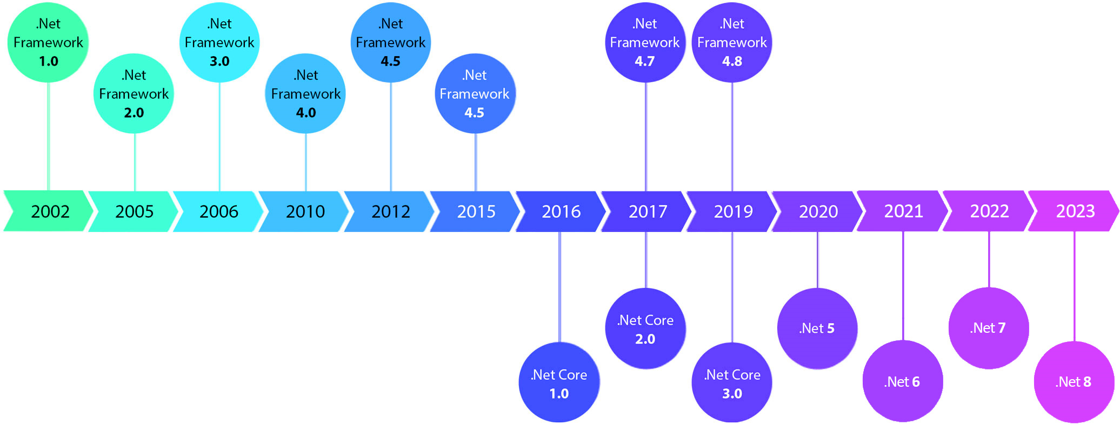
ASP.NET Core Version History Cont..

Slide 6
Advantages: ASP.NET Core
Open Source
Cross-platform development and deployment
Modular Features
Focus on performance as a feature
A simplified hosting model
The option to package .NET with an app when publishing for standalone deployments

Slide 7
What Type of Application Can You Develop with ASP.NET Core?
Web: ASP.NET Core MVC, Web API, Razor Pages, and Micro services
Mobile
Console
Desktop Applications
IoT
ML
Gaming Applications
Cloud Applications
& Many More…

Slide 8
Creating a MVC Project
Section – 2.1.1

Slide 9
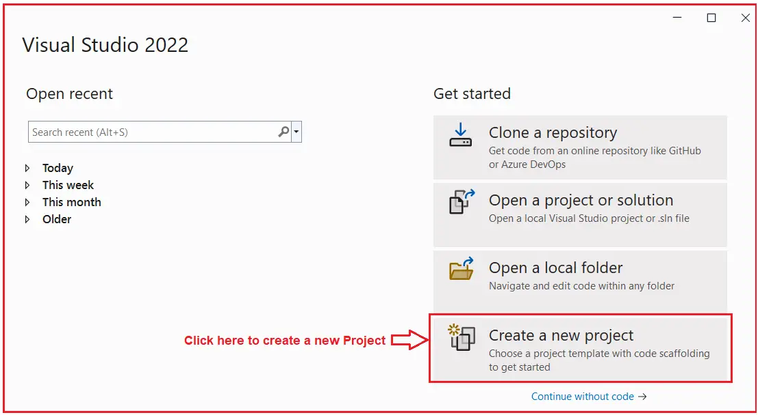
Creating a MVC Project
First of all, open Visual Studio 2022 and then click on the Create a new project tab as shown in the image.

Slide 10
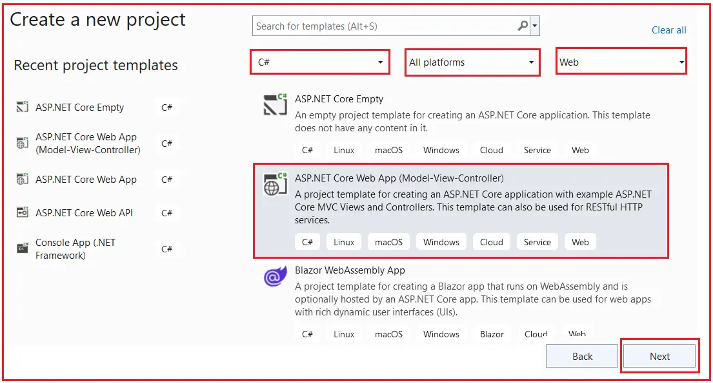
Creating a MVC Project Cont..
From this window, select “C#”, “All Platforms” and “Web” from the respective dropdowns as highlighted below.
Search for the Model-View-Controller template.
Select “ASP.NET Core Web App (Model-View-Controller)” as highlighted below and click on the “Next” button as shown in the image.

Slide 11
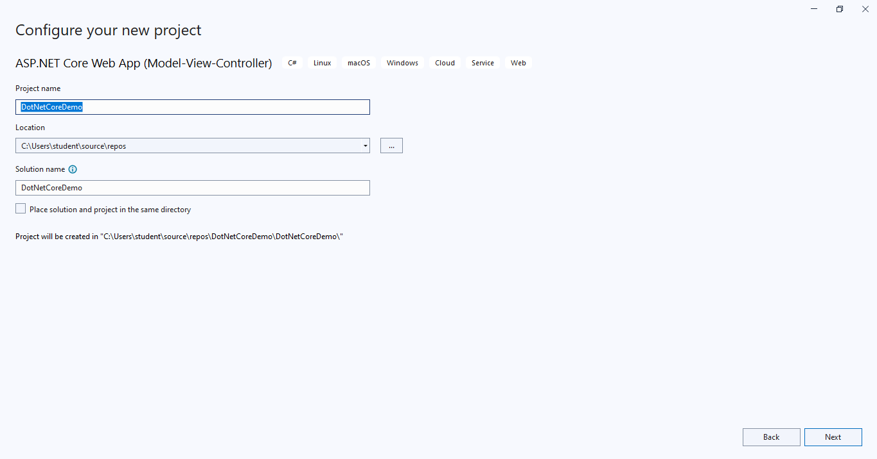
Creating a MVC Project Cont..
Once you click on the Next button, it will open the Configure Your New Project window.
Give an appropriate name for the project DotNetCoreDemo, set the location where you want to create this project, and the solution name for the ASP.NET Core Web application.
And finally, click on the Next button as shown in the image.

Slide 12
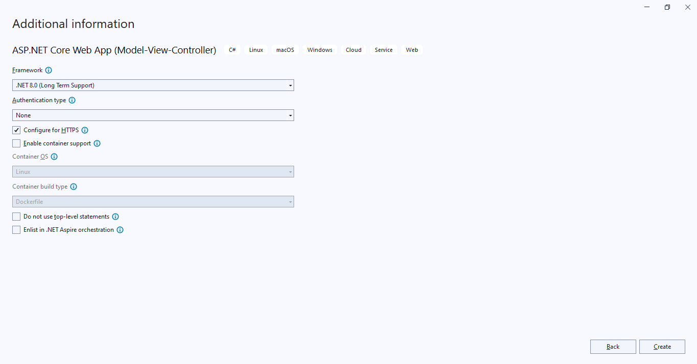
Creating a MVC Project Cont..
Once you click on the Next button, it will open the following Additional Information window.
Here, you need to select “Framework” – “.NET 8.0 (Long Term Support)”, “Authentication type” – “None”.
You also need to uncheck the Configure for HTTPS and Do not use top-level statements check boxes and finally click on the Create button as shown in the below image.

Slide 13
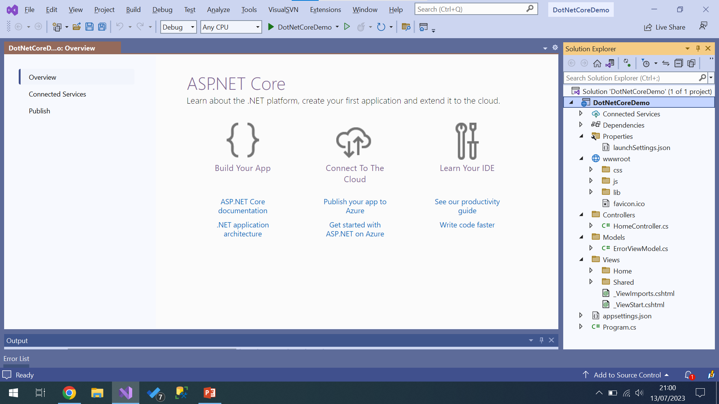
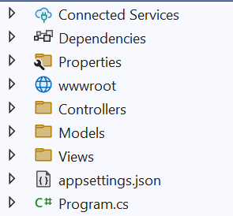
Creating a MVC Project Cont..
Once you click on the Create Button, the project is going to be created with the Model-View-Controller template with the following folder and file structure.

Slide 14
MVC Project Structure
Dependencies is the place where the necessary dll’s for the application are stored.
Under the Properties menu, you will see a file called launchSettings.json which describes how a project can be launched.
It describes the command to run, whether the browser should be opened, which environment variables should be set, and so on.
Static content is hosted in the wwwroot folder. The content such as CSS, Javascript files and Bootstrap, jquery libraries need to be included here.
Controller, Models and Views folders are automatically created as we chose Web Application (Model-View-Controller).
appsettings.json is used to store information such as connection strings or application specific settings and these are stored in the JSON format as the file extension suggests.
Program.cs file in ASP.NET Core MVC application is an entry point of an application. It contains logic to start the server and listen for the requests and also configure the application.

Slide 15
MVC Architecture
Model
View
Controller
Section – 2.2

Slide 16
MVC Architecture
MVC stands for Model View and Controller.
It is an architectural design pattern that means this design pattern is used at the architecture level of an application.
When we want to design an application, first we think about the architecture of application, and MVC plays an important role in the architecture.
MVC is a powerful and elegant means of separating concerns within an application.
So, the point is MVC is not a programming language, MVC is not a Framework, it is a design pattern.
MVC Design Pattern is basically used to develop interactive applications.
Each of these layers has very specific set of responsibility.
The Model layer contains the data.
The View renders the Model to the user and handles user interactions.
The View passes the user interactions to the Controller, which in turn builds the model and update the View.

Slide 17
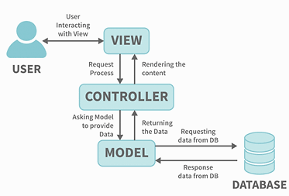
MVC Architecture Pattern Cont..
Separation of concerns
The Separation of concerns philosophy states that each component of the application is responsible for only one thing.
They should do not depend upon any other component as much as possible.
In other words, the components should be loosely coupled with other.
The application built using such a concept is easily testable, maintainable and extensible.

Slide 18
Example: MVC Architecture
URL: https://darshan.ac.in/how-to-apply
View
Controller
Model
Router
Selects the right controller to handle a request.
how-to-apply | Action method of particular controller will be called.

Slide 19
View(s)
A view is a file with a “.cshtml” (for C# language) extension.
The meaning of cshtml = CS (C Sharp) + HTML
The Views in ASP.NET Core MVC are HTML templates with embedded Razor markup which generate content that sends to the client.
That means the view is a combination of programming language (C#) and HTML (Hypertext Mark-up Language).
The Views in ASP.NET Core MVC Application are generally returned from the Controller Action Method.
It is responsible for UI i.e. application data presentation.
That means we display information about the website on the browser using the views only.
A user generally performs all the actions on a view such as a button click, navigation, list, and other UI elements etc.

Slide 20
View(s) Cont..
By default, Views are available inside the Views folder at the root.
Usually, views are grouped into folder names with the applications controller.
Each controller will have its own folder in which the controller-specific view files are going to be stored.
The controller-specific folders are going to be created within the Views folder only.
View file name may be the same as the action method name of a controller. (if it differs then you need to specify the view name)

Slide 21
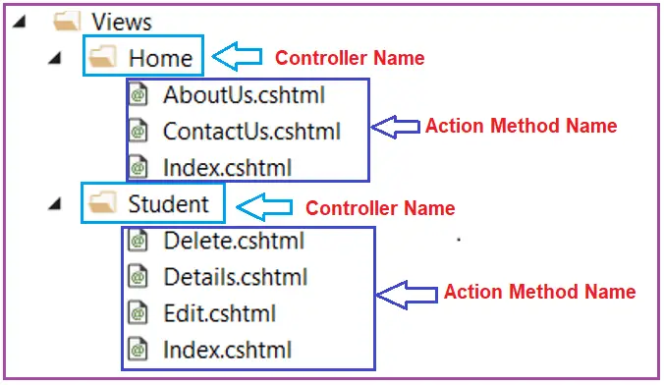
View(s): Example
Let’s say, we have an ASP.NET Core MVC application with two controllers
i.e. HomeController and StudentController.
The HomeController is created with the following three action methods.
AboutUs()
ContactUs()
Index()
On the other hand, the StudentController is created with the following four action methods.
Index()
Details()
Edit()
Delete()

Slide 22
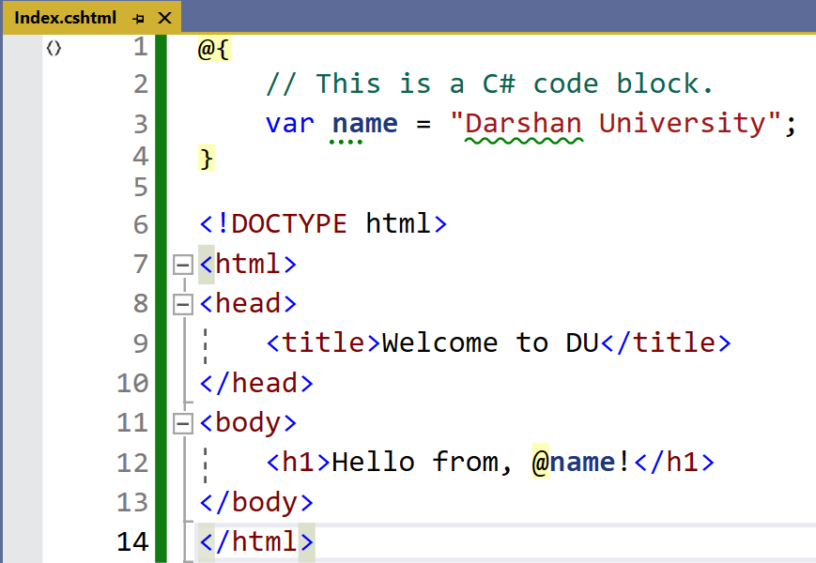
View (Code) : Example
C#
HTML

Slide 23

Guess the Views of Student Management System Project!!!
Student
Student List
Student Add
Student Edit
Student View
Student Timetable
Student Fees
Student Assignment
Student Result

Slide 24
Advantages of Views (Why Views?)
Views are an important part of the ASP.NET Core MVC framework.
They allow you to separate the presentation layer of application from the business logic and data access layers.
With the help of views, application is easy to maintain and develop (Different Screens).
Separation of concerns:
Views are responsible for the presentation layer of the application, while controllers are responsible for the business logic and data access layers.
Reusability:
Views can be reused in different parts of the application.
This can save time and effort when developing the application.
Flexibility:
Views can be customized to meet the specific needs of the application.
This makes the application more flexible and adaptable.

Slide 25
Remember!!!
Adding a View
Click on your Views Folder, Inside Views folder there is controller specific folder 📁.
On that specific controller folder 📁, right click on it and go to Add→View→Razor View – Empty.
Give view name and press Add.
Searching View Behavior
The default behavior of the View method (i.e., return View();) is to return a view with the same name as the action method name from which it is being called.
For example, the Index ActionResult method of the Home controller is used to search for a view file with the name Index.cshtml in the following two locations.
First, it will look for the “Index.cshtml” file within the /Views/Home, i.e., Views/[ControllerName] folder, as the action method belongs to Home Controller.
Then it will look for the “Index.cshtml” file in the “/Views/Shared/” folder.
Then it will look for the “Index.cshtml” file in the “/Pages/Shared/” folder.

Slide 26
Controller
A Controller is a special class in ASP.NET Core Application with .cs (for C# language) extension.
By default, when you create a new ASP.NET Core Application using Model View Controller (MVC) template, then you can see the Controllers are residing in the Controllers folder.
In ASP.NET Core MVC Application, the controller class should and must be inherited from the Controller base class.
The Controllers in the MVC application logically group similar types of actions together.
This aggregation of actions or grouping of similar types of action together allows us to define sets of rules such as caching, routing, and authorization which are going to be applied collectively.

Slide 27
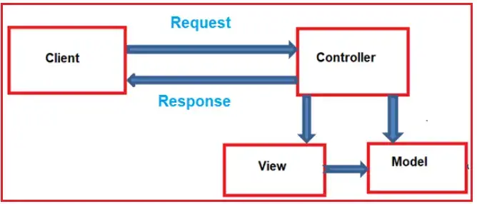
Controller Cont..
When the client (browser) sends a request to the server, then that request first goes through the request processing pipeline.
Once the request passes the request processing pipeline, it will hit the controller.
Inside the controller, there are lots of methods (called action methods) actually handle that incoming HTTP Requests.
The action method inside the controller executes the business logic and prepared the response which is sent back to the client who initially made the request. (See below image)

Slide 28
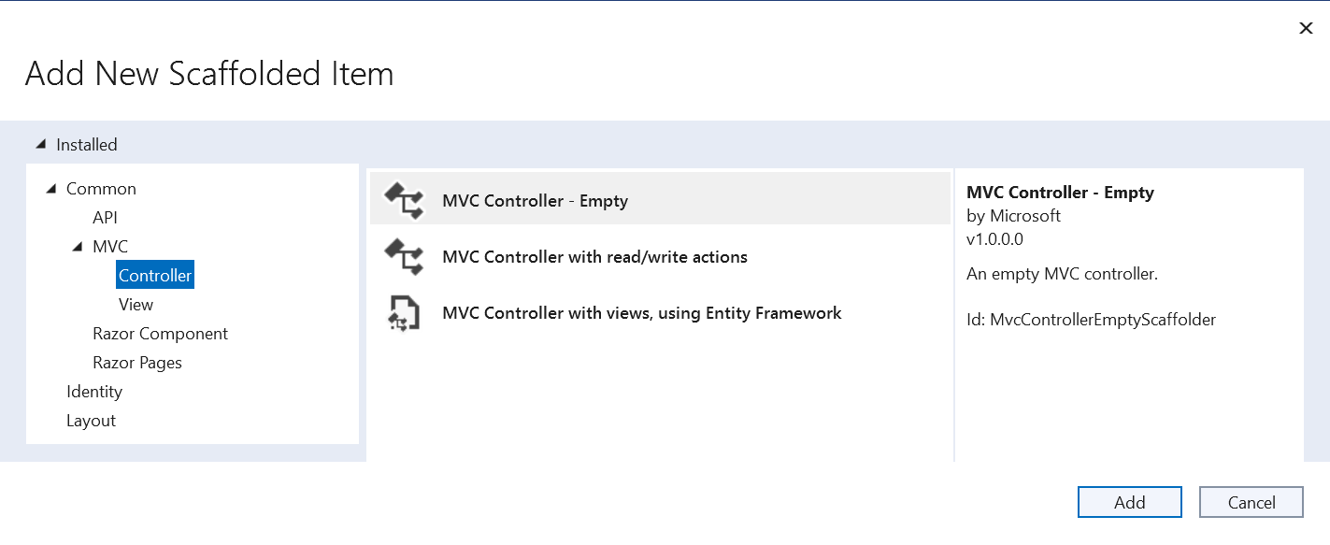
Adding Controller in ASP.NET Core Project
Right-click on the Controller folder and select the Add => Controller option from the context menu which will open the Add Controller window as shown in the below image.
Here, we are going to create the MVC Controller with the Empty template.

Slide 29
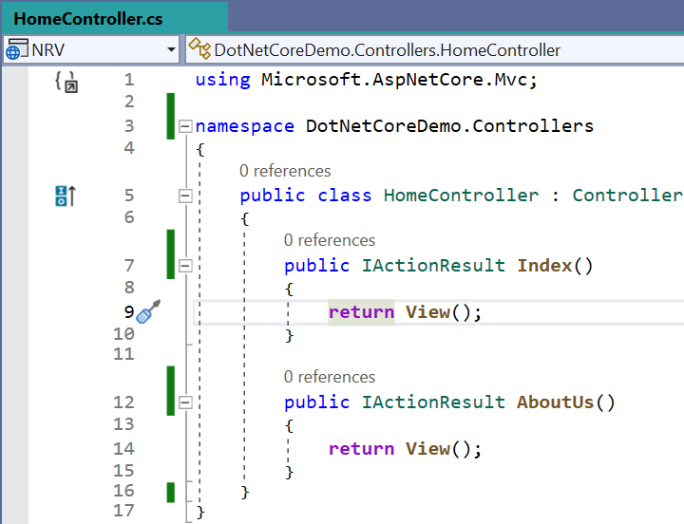
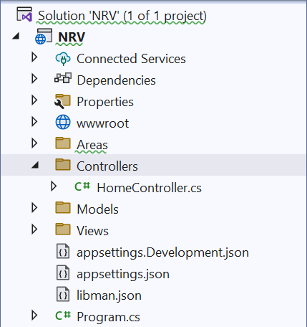
Controller Cont..

Slide 30
Controller Cont..
Role of Controller in MVC
A Controller is used to group actions i.e. Action Methods.
The Controller is responsible to handle the incoming HTTP Request & Response.
The Mapping of the HTTP Request is done using Routing & that is for a given HTTP Request, which action method of which controller is going to invoke is handled by the Routing Engine.
Many important features such as Caching, Routing, Security, etc. can be applied to the controller.
Attributes also can be applied at the Controller level i.e. Routing

Slide 31
Model
A model is a class that contains the business logic of the application.
It also used for accessing data from the database.
The model class does not handle directly input from the browser.
It does not contain any HTML code as well.
Models are also refers as objects that are used to implement conceptual logic for the application.
A controller interacts with the model, access the data, perform the logic and pass that data to the view.
It represents a set of classes that describes the business logic and data.
By default, models are stored in the Models folder of the project.
In short, model represents a set of classes that are used to describe the application’s validation logic, business logic, and data access logic.

Slide 32
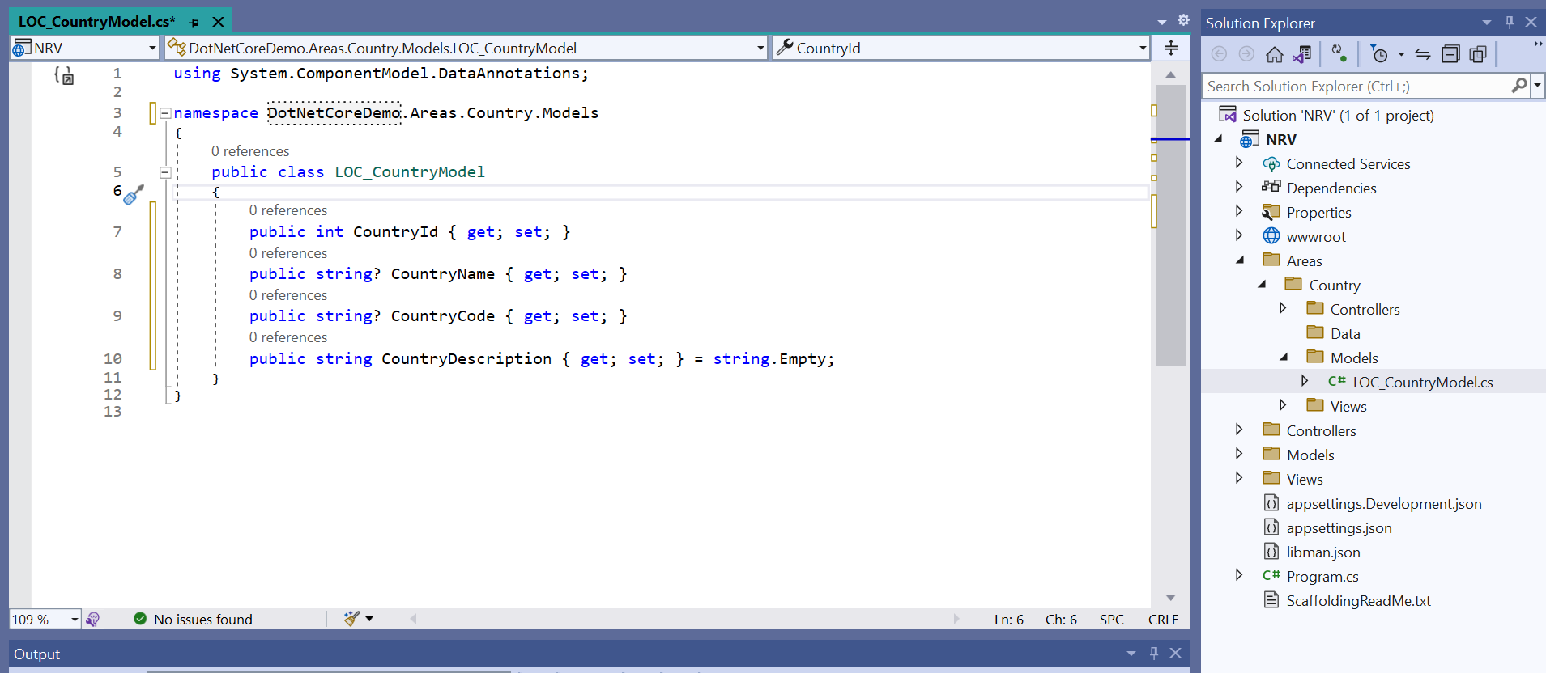
Model Example
To Add Model In Project Right Click on Models Folder → Add → Class

Slide 33
Summary - MVC Architecture Pattern
Model
The model represents the data that needs to be shown to the user and some associated logic.
It is an object or just another c# class with properties and methods.
The model does not and should not depend on Controller or View.
The only responsibility of the model is to hold the data. The model class is ideally reusable.
View
The view is a visual representation of the model.
Responsible for interacting with the User.
Render the model to the user.
Accept User interaction and pass it to controller.
Consists of Standard HTML Pages / JavaScript and CSS.
Should be able to Render JSON, XML and custom return types.
Controller
The Controller receives the request.
Process incoming requests from the user.
Passes the validations and errors back to View if any.
The controller acts on both side model and view.
Controllers are the components that manage user input, interact with the model, and choose which view to render.

Slide 34
Different Types of Razor View Files in Project
Section – 2.3

Slide 35
Different Types of Razor View Files in Project
All Razor files ends with .cshtml.
Most of Razor files are intended to be browsable and contains a mixture of client-side and server-side code, when it is processed, results in HTML being sent to the browser.
These pages are usually referred to as "content pages".
Also other Razor files have a leading underscore (_) in their file name like _Layout.cshtml , _ViewStart.cshtml, _ViewImports.cshtml etc.
The leading underscore in the file name indicates that these files are not intended to be served directly by the browser.

Slide 36
Different Types of Razor Files
Razor files are used in ASP.NET Core to create dynamic web pages with a mix of HTML and C# code. Here are the different types of Razor files:
Content Pages:
These are the most common Razor files, ending with .cshtml.
They contain a mix of client-side and server-side code, which results in HTML being sent to the browser.
Partial Pages:
These files also end with .cshtml but have a leading underscore (e.g., _Partial.cshtml).
They are not intended to be browsable directly and are used to include reusable components in other pages.
Layout Pages:
The _Layout.cshtml file acts as a template for other content pages.
It typically includes the site’s header, footer, and navigation, ensuring a consistent design across the site.
View Start Pages:
The _ViewStart.cshtml file contains code that runs before any content page in the same folder or subfolders.
It’s often used to specify the layout file for all affected content pages.
View Imports Pages:
The _ViewImports.cshtml file is used to include directives that should be available to all Razor pages in a folder hierarchy, such as namespaces and tag helpers.

Slide 37
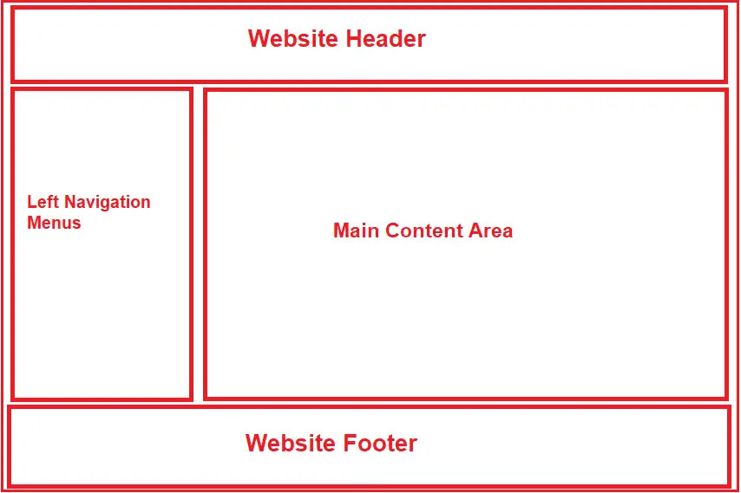
_Layout.cshtml
The _Layout.cshtml file acts as a template for all content pages that reference it.
Consistent part of a site's design are declared in the _Layout.cshtml file.
These can include the header, footer, site navigation, main content area and so on.
Typically, the _Layout.cshtml file also includes the <head> section of the page, so they also reference the common CSS style sheet files and JavaScript files.
If you want to make changes to the overall design of the site, you often only need to make adjustments to the content of the _Layout.cshtml.
In ASP.NET Core MVC, creating multiple layout files for a single application is possible.
For example, you may have one layout file for the admin users and another layout file for non-admin users of your application.

Slide 38
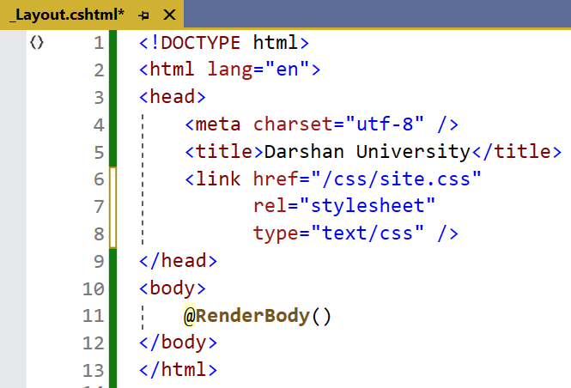
_Layout.cshtml
We can say that the common UI code, which can be used in many views, can go into a common view called _Layout in application.
As the layout views are not specific to any controller.
As the layout view will be used across multiple views of our application, we usually place the layout views in a Shared subfolder within the Views folder.
By default, in ASP.NET Core MVC App, the layout view file is named _Layout.cshtml. But you can change the name if you wish.

Slide 39
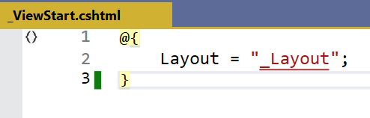
_ViewStart.cshtml
The _ViewStart.cshtml file contains code that executes after the code in any content page in the same folder or any child folders.
It provides a convenient location to specify the layout file for all content pages that are affected by it, and that is typically what you see in the _ViewStart.cshtml file that comes with any Razor Pages (or MVC) template.

Slide 40
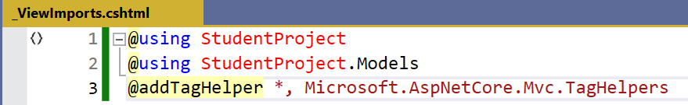
_ViewImports.cshtml
It is a special Razor view file that allows us to specify the common namespaces, directives, and other elements, that will be automatically imported and applied to all views within a specific directory and its subdirectories.
It helps us to simplify the Razor syntax and reduce repetitive code by centralizing the import statements in one place.

Slide 41
Partial Views
Section – 2.4

Slide 42
Introduction : Partial View
Partial Views are just a view that can be reused across the web application.
So, Partial Views can act as a pluggable reusable block that we can call from anywhere in the application and the content of the partial view is displayed.
Whenever we use Partial Views, it must be rendered as a child view.
It is very helpful as a reusable component or in the case of splitting a large interface into small parts.
We can create a partial view just like regular views and this view can be returned from the controller using ViewResult.
The main difference is that the partial view does not run _ViewStart.cshtml before the rendering and also, the partial view is rendered within another view.
Partial view passes the name of the partial and also can pass a model data which is optional.
A partial view is normally rendered in the main views using @Html.Partial() method.
A partial view are not associated with a layout page and cannot be called directly by a URL.

Slide 43
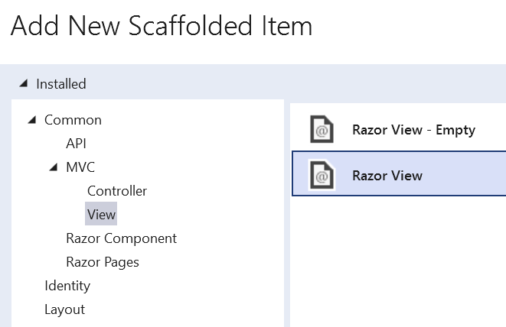
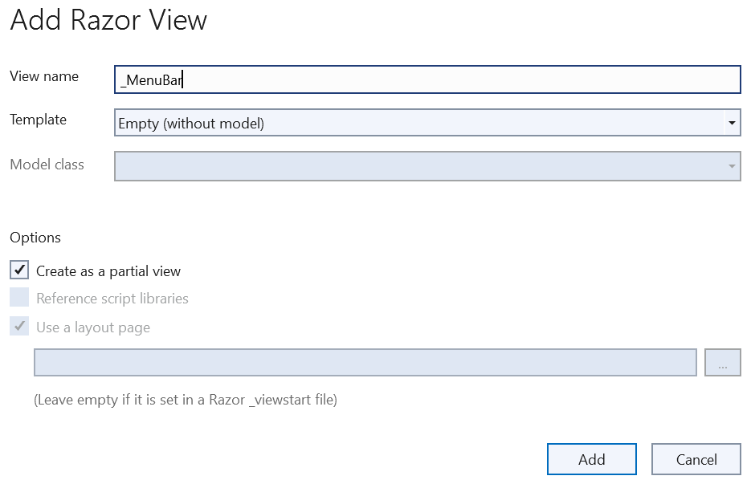
Creating a New Partial View from Visual Studio
To create a partial view, right click on the Shared folder -> click Add -> click View to open the Add View popup, as shown below.

Slide 44
Rendering a Partial Views
You can render the partial view in the parent view using the HTML helper methods:
@Html.Partial("_PartialViewName") OR <partial name="_PartialViewName"/>
This helper method always renders the partial view in the application.
This method always takes one argument as a string in which we normally specify the partial view name as a string and it returns the view content as MvcHtmlString type value.
It always returns the content of the views as HTML and this gives us the facility to change or modify the HTML part before rendering.
@{Html.RenderPartial("_PartialViewName");}
This method is the same as the @Html.Partial() method except that it writes the resulted HTML of a specified partial view into an HTTP response stream directly.
So, you can modify it's HTML before render.

Slide 45
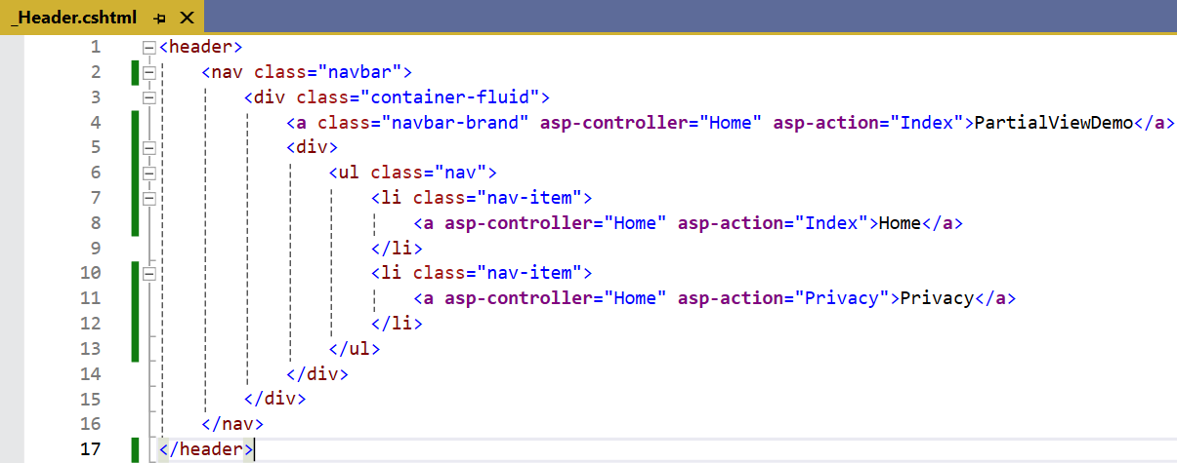
Example: Partial View
_Header.cshtml

Slide 46
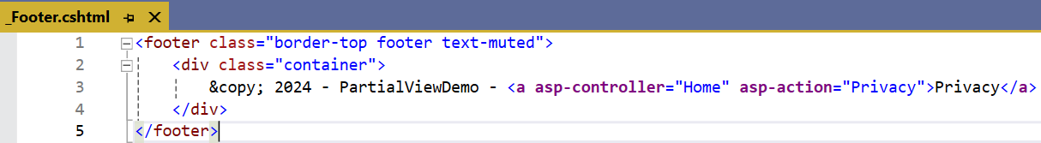
Example: Partial View Cont..
_Footer.cshtml

Slide 47
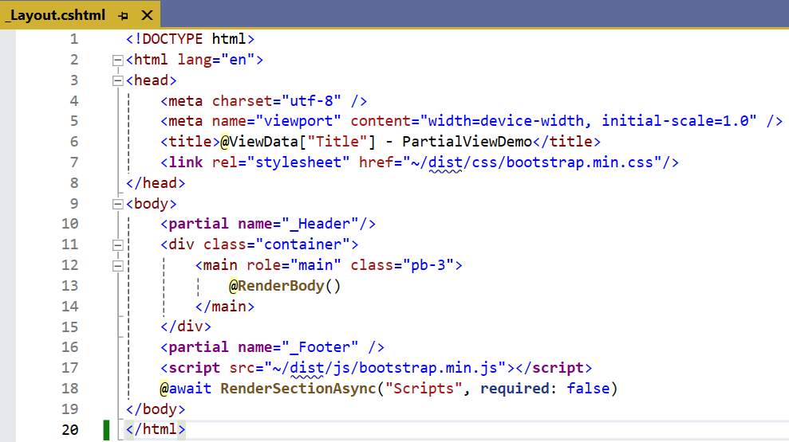
Example: Partial View Cont..
_Layout.cshtml

Slide 48
Views v/s Partial Views
Views | Partial Views
View contains the layout page | Partial View does not contain the layout page
Before any view is rendered, viewstart page is rendered | Partial view does not verify for a viewstart.cshtml page
View might have markup tags like body, html, head, title, Meta etc. | Partial view is designed specially to render within the view and just because of that it does not consist any mark up tag
View is not lightweight as compare to Partial View | Partial view is lightweight
A "View" in the context of web development typically refers to the template or markup that defines the structure and presentation of the entire page. | Partial view is a reusable piece of a view that can be included in multiple views.
Views are typically rendered as complete pages. | Partial Views are embedded within views and can be dynamically loaded or included where needed.
Views are typically not as reusable as partial views because they often encapsulate a specific page's structure and content. | Partial Views are designed for reusability, you can include the same partial view in multiple views to maintain consistent UI elements across different parts of your application.

Slide 49
Advantages: Partial Views
Reusability- A partial view can be reused in multiple views, which can save your time and reduce duplication of code.
Separation of concerns- By breaking down a larger view into smaller partial views, you can separate different parts of the view into their own logical units, making it easier to manage and maintain your code.
Modularity- Using partial views can make your application more modular, which can make it easier to add new features or update existing ones.
Performance- By using partial views, you can optimize the rendering of your views and reduce the amount of HTML that needs to be sent to the browser. This can lead to faster page load times and a better user experience.
Flexibility- Partial views can be used to render different types of content, such as lists, forms, or navigation menus. This makes it easier to create dynamic, responsive user interfaces that can adapt to different screen sizes and device types.

Slide 50
Data Passing Techniques
Section – 2.5

Slide 51
Data Passing Techniques
The following are the scenarios where we can use these objects.
Pass the data from Controller to View.
Pass the data from one action to another action in the same Controller.
Pass the data in between different Controllers.

Slide 52
ViewBag
ViewBag is lightweight method of transferring values to Controllers to Views.
ViewBag only transfers data from action methods to views, not visa-versa.
ViewBag values are lost if redirection occurs in the action method.
Once the ViewBag values are read, DOTNET will remove it from the memory. This means to reuse these values you will have to store them in some variables.
HomeController.cs
1
2
3
4
5
public IActionResult Index()
{
ViewBag.Title = "Welcome";
return View();
}
Index.cshtml
1
<h2>@ViewBag.Title</h2>

Slide 53
ViewData
ViewData is a dictionary object to pass the data from Controller to View where data is passed in the form of key-value pair.
Typecasting is required to read the data in View if the data is complex and we need to ensure null check to avoid null exceptions.
The scope of ViewData is similar to ViewBag and it is restricted to the current request and the value of ViewData will become null while redirecting.
HomeController.cs
1
2
3
4
5
public IActionResult Index()
{
ViewData["Title"] = "Welcome"; return View();
}
Index.cshtml
1
<h2>@ViewData["Title"]</h2>

Slide 54
TempData
TempData is a dictionary object to pass the data from one action to other action in the same Controller or different Controllers.
Tempdata is also required to typecast and for null checking before reading data from it.
TempData scope is limited to the next request and if we want Tempdata to be available even further, we should use keep() and peek().
HomeController.cs
Index.cshtml
1
2
3
4
5
6
7
8
9
10
public IActionResult Index()
{
TempData["Data"] = "I am from Index action"; return View();
}
public string Get()
{
return (string)TempData["Data"];
}
1
<h2>@TempData["Data"]</h2>

Slide 55
Summary | Passing Data
MVC automatically removes the values of the TempData as soon as they are read.
There is ‘Keep’ method to prevent MVC from removing the value once read.
However, if the value is read again (2nd time) then MVC will delete it.
The ‘Peek’ method allows you to get the value and also prevent it from deletion.
This is because it does not tell MVC that the value has been read.
We may Use session to store the value permanently (until the session expires) for as many reads as you want and in any part of the application.

Slide 56
Action & Non Action Methods
Section – 2.6

Slide 57
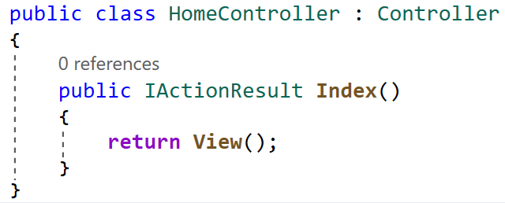
Action Methods
Home Controller Class
Base Controller Class
Return Type
Action Method
View() UI defined in base
Controller class

Slide 58
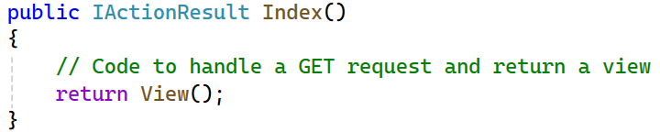
Action Methods Cont..
Action methods are responsible for handling HTTP requests and returning HTTP responses.
They are the methods that perform specific actions in response to user requests.
These methods are typically associated with URLs and are used to execute specific functionality based on the request type (e.g., GET, POST, PUT, DELETE).
Action methods are public and typically return an ActionResult or one of its derived types (e.g., ViewResult, JsonResult, RedirectToActionResult) to determine the response to send back to the client.
Let’s see example of an action method in a controller:

Slide 59
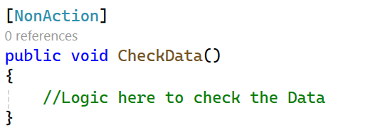
Non-Action Methods
Non-action methods are regular methods in a controller that are not intended to be used as entry points for handling HTTP requests.
They are auxiliary methods used to factor out common functionality or logic to be shared among action methods.
Non-action methods are typically marked with the [NonAction] attribute to explicitly indicate that they should not be invoked as actions.
These methods cannot be directly accessed via a URL, and they do not return ActionResults.
Let’s see example of an action method in a controller:

Slide 60
IActionResult Object
Section – 2.7

Slide 61
IActionResult Object | Return Types
These include various result types derived from ActionResult,
ViewResult
JsonResult
ContentResult
StatusCodeResult
FileResult
RedirectResult

Slide 62
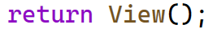
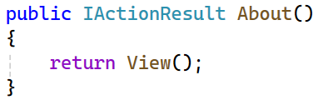
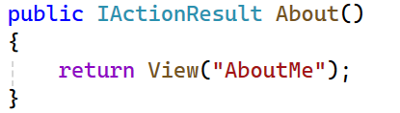
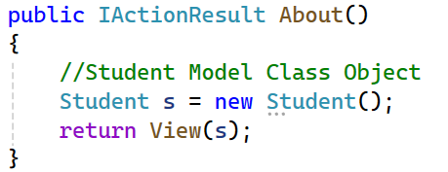
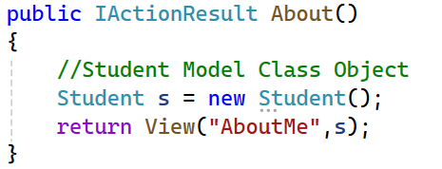
1. ViewResult Object
The View method creates a ViewResult object by defining a model which will be transferred to the View.
Represents an HTML view template that should be rendered and returned as a response.
Typically used for rendering HTML pages to be displayed in a web browser.
The View() method has 4 different overloaded versions which are described in the below table:

Slide 63
1. ViewResult Object Cont..
Method | Description
View() | Targets the default View to render it. E.g. if the action method name is List and you are using the View() method (with empty parameter) then the List.cshtml view will be rendered.
View("ViewName") | This version takes the view name in it’s parameter and this view will be rendered. E.g. if you use View("Show") then the show.cshtml view will be rendered.
View(model) | This version will render the default view by providing it with model data (class object). This is used to make the rendered view strongly typed.
View("ViewName", model) | This version specifies the View by it’s name along with the model data that it will be provided with.

Slide 64
2. JsonResult Object
JsonResult represents an HTTP response containing JSON data (i.e., key-value pairs).
It is used when we want to return JSON-formatted data from a controller action method to the client.
JSON (JavaScript Object Notation) is a lightweight data-interchange format that is easy for humans to read and write and for machines to parse and generate.
When we return a JsonResult from a controller action, ASP.NET Core MVC serializes the specified data into JSON format and sends it back to the client as the HTTP response body.
This is commonly used for AJAX requests where the client-side JavaScript code expects to receive data in JSON format or when building APIs.

Slide 65
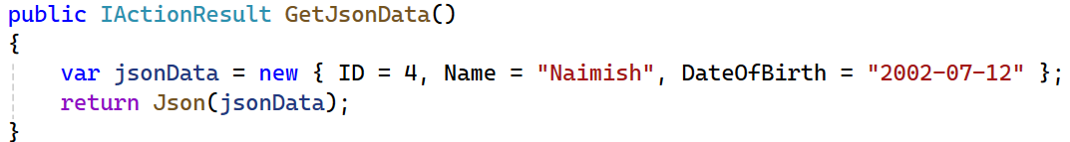
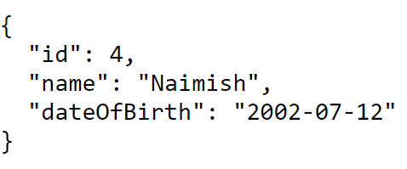
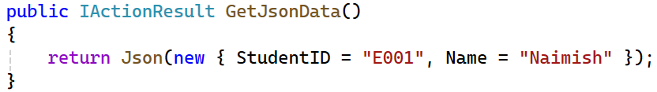
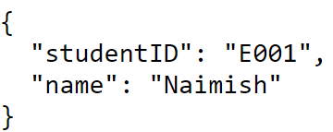
2. JsonResult Object Cont..

Slide 66
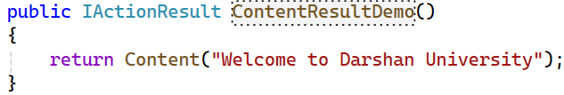
3. ContentResult Object
It is a type of ActionResult that returns a string or binary content to the client.
It's commonly used for returning files, images, or other types of content.
Here are some key properties and methods of the ContentResult object:
Content: The content to be returned to the client.
ContentType: The MIME type of the content.
StatusCode: The HTTP status code to be returned with the content.
You can use ContentResult to return different types of content, such as:-
Text: return Content("Hello, World!", "text/plain")
Image: return Content(imageBytes, "image/jpeg")
File: return Content(fileBytes, "application/octet-stream", fileName)

Slide 67
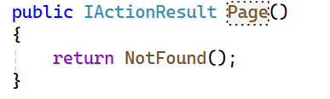
4. StatusCodeResult Object
Represents an HTTP status code without a specific content response.
Used for returning HTTP status codes like 404 (Not Found), 500 (Internal Server Error), etc.

Slide 68
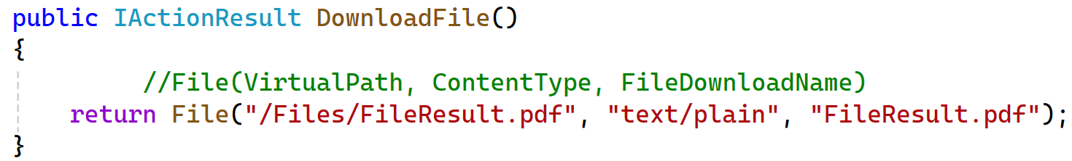
5. FileResult Object
The FileResult class is used to return files from a controller action.
It is an action result that represents a file to be returned to the client for download or display.
This is the parent class of all file-related action results.
It’s a base class used to send binary file content to the response.
When executed, it writes a file as the response.
This can be useful for scenarios where you need to send a file to the client, such as downloading a document, image, or any other type of file.

Slide 69
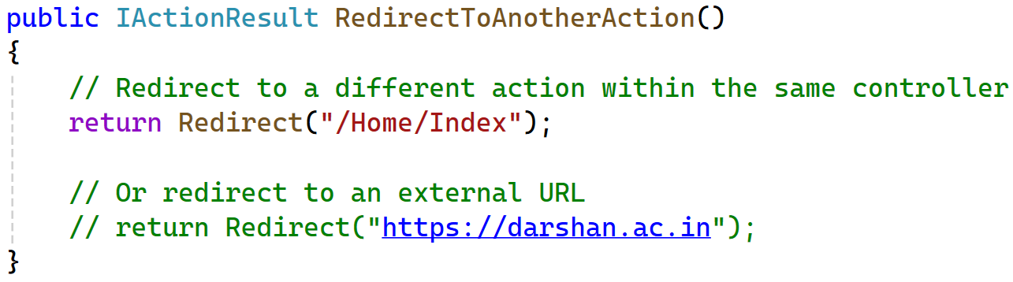
6. RedirectResult
The RedirectResult class in ASP.NET MVC Core is an ActionResult used to instruct the user's browser to navigate to a different URL.
It's a handy tool for managing the flow of your web application, especially in scenarios like:
After form submissions: Redirect the user to a confirmation page or a success message.
Login operations: Redirect to the main dashboard after successful login.
Conditional navigation: Based on user roles or actions, redirect them to specific pages.
External URLs: Redirect to external sites for authentication or other purposes.
It sends an HTTP status code of 302 (Found) by default, which tells the browser to perform a temporary redirect to the specified URL.

Slide 70
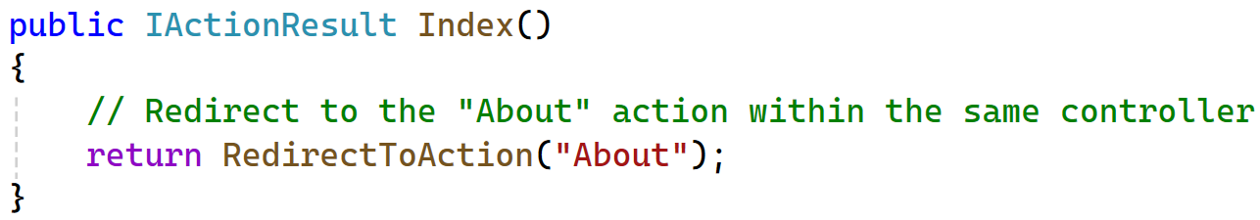
RedirectToAction
RedirectToAction method is used to redirect users from one action method to another within the same or different controller.
It’s commonly used for navigation and routing purposes.
The RedirectToAction method sends an HTTP status code of 302 (Found) by default, instructing the browser to perform a temporary redirect to the specified action.
You can also specify a permanent redirect by sending a 301 status code, which performs a standard HTTP redirection.
Here’s an example of using RedirectToAction to redirect from the current action to another action within the same controller:

Slide 71
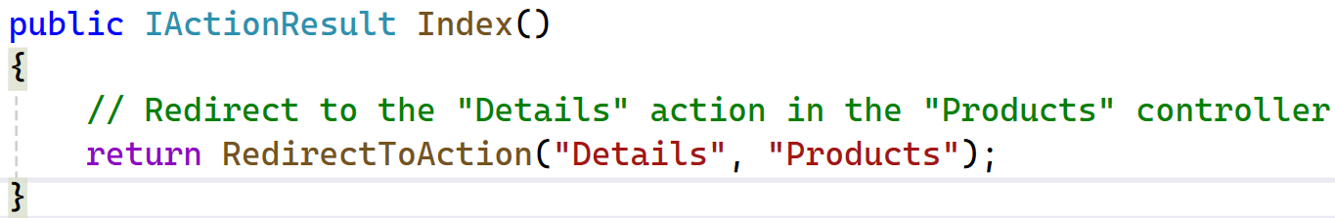
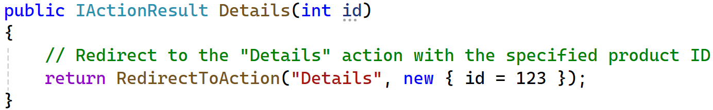
RedirectToAction Cont..
Redirecting to a Different Controller
If you want to redirect to an action in a different controller, you can specify both the controller name and the action name:
Passing Route Values
You can also pass route values (parameters) to the target action. For example, redirecting to an action with an id parameter

Slide 72
ASP.Net Core Life Cycle
Section – 2.8

Slide 73
ASP.Net Core Life Cycle
Application Start
The program.cs class is executed when the application starts.
This class configures services and the request pipeline.
Middleware Pipeline
Middleware components are executed in the order they are added to the pipeline.
Each middleware can handle requests and responses, and decide whether to pass the request to the next middleware.
Routing
The routing middleware matches the incoming request to a route.
It determines which controller and action method should handle the request.
Controller Initialization
The selected controller is instantiated, and its dependencies are injected.
Action Method Execution
The action method of the controller is executed.
This method processes the request and prepares the response.
Result Execution
The result from the action method (e.g., a view, JSON data) is executed.
If it’s a view, the view engine renders the HTML.
Response
The final response is sent back to the client.

Slide 74
Middleware in ASP.NET Core
Section – 2.9

Slide 75
Middleware in ASP.NET Core Cont..
Middleware is one of the core functionalities of any ASP.NET Core Web Application.
When we send a request from the client to the server, middleware comes into the picture.
HTTP Request Pipeline:
Before understanding ASP.NET Core Middleware components, let us first understand what is HTTP Request Pipeline and how does it work.
Please have a look at the following image for a better understanding of the HTTP Request Pipeline.
As you can see in the below image, on the left-hand side, we have the client i.e. a browser and on the right-hand side, we have the server where our ASP.NET Core Web API application is hosted.
Further, the Web API Application has three controllers.
So, when the client sends a request to the server, we generally believe that it is the controller action method that is going to serve the request and then we get the response.
HTTP Request
Controller1
Controller2
Controller3
Client
HTTP Response
Web Browser
Web Server

Slide 76
Middleware in ASP.NET Core Cont..
But in reality, before hitting the controller action method, the request has to pass through a pipeline.
Once the pipeline is completed, then only it navigates the request to the corresponding controller action method as shown in the below image.
Pipeline
HTTP Request
Client
Controller1
Controller2
Controller3
HTTP Response
Web Browser
Web Server

Slide 77
HTTP Request Pipeline in ASP.NET Core
Now the confusion is what is Middleware?
Let us assume a middleware is a piece of code with some logic.
Middleware 1
Middleware 2
Middleware 3
HTTP
Request
Logic
Next();
Logic
Next();
Logic
Logic
Logic
HTTP
Response
Controller
BAL
DAL

Slide 78
HTTP Request Pipeline in ASP.NET Core Cont..
Whenever a request comes from a client to the server, then the request comes to the first middleware which is registered in the request pipeline.
In our case it is Middleware1. The code or logic which is there in Middleware1 will be executed and then if it will call the next method, then the request goes to the next middleware which is registered in the request processing pipeline i.e. Middlware2.
The code or logic which is there in Middleware2 will be executed and if it calls the next method, then it navigates to the request to the next middleware i.e. Middleware3. Let us assume, in Middleware3, we don’t have the next method.
So, the code or logic which is there in Middleware3 will be executed and as there is no next method call, so the request will come back to the previous middleware i.e. Middleware2.
And if there is some code after the next method in Middleware2, then those codes will be executed and once the code executed the request again comes back to the previous middleware i.e. Middlwware1.
Similarly, if there is some code after the next method in Middleware1, then those codes will be executed and once the code gets executed the final response sends to the client who initially made the request.

Slide 79
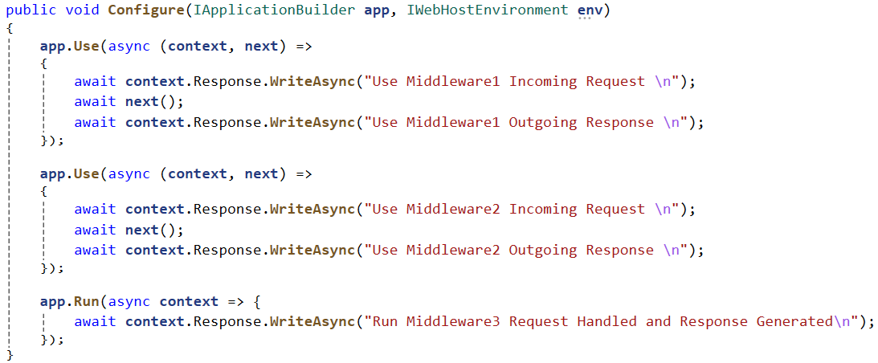
HTTP Request Pipeline in ASP.NET Core Example Cont..

Slide 80
Middleware in ASP.NET Core Cont..
Middleware is a piece of code that is used in the HTTP Request Pipeline.
An ASP.NET Core Web API Application can have n number of middlewares.
So, depending upon the requirement, we can configure n number of middlewares in the application request processing pipeline.
The order of middleware matters a lot in the execution.
That means in the order they are configured into the request processing pipeline; in the same order, they are going to be executed when a request comes (response).
Each middleware in the ASP.NET Core Web API Application performs the following tasks.
Chooses whether to pass the HTTP Request to the next component in the pipeline. This can be achieved by calling the next() method within the middleware.
It can perform work before and after the next component in the pipeline.
ASP.NET Core provides some built-in middleware that is ready to be used, even if you want then you can also create your own custom middleware.

Slide 81
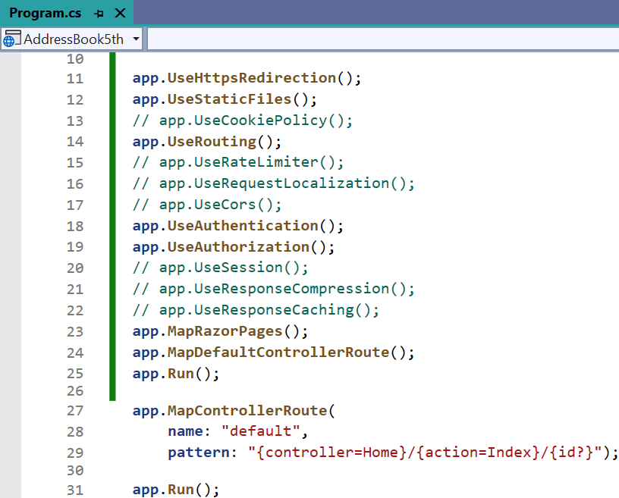
Middleware in ASP.NET Core Cont..
The most important point that you need to keep in mind is, in ASP.NET Core a given Middleware component should only have a specific purpose i.e. single responsibility.
Middleware Examples:
Routing: If you want to implement Routing in your application, then you need to use Routing Middleware in the HTTP Request Processing pipeline.
Authentication: If you want to authenticate the user then you need to use Authentication Middleware.
Authorize: The Authorize Middleware is used to Authorize the users while accessing a specific resource.
Log: If you want to log request and response while processing, then you need Middleware.
Exception Middleware: You can also use Middleware to handle the exception globally.

Slide 82
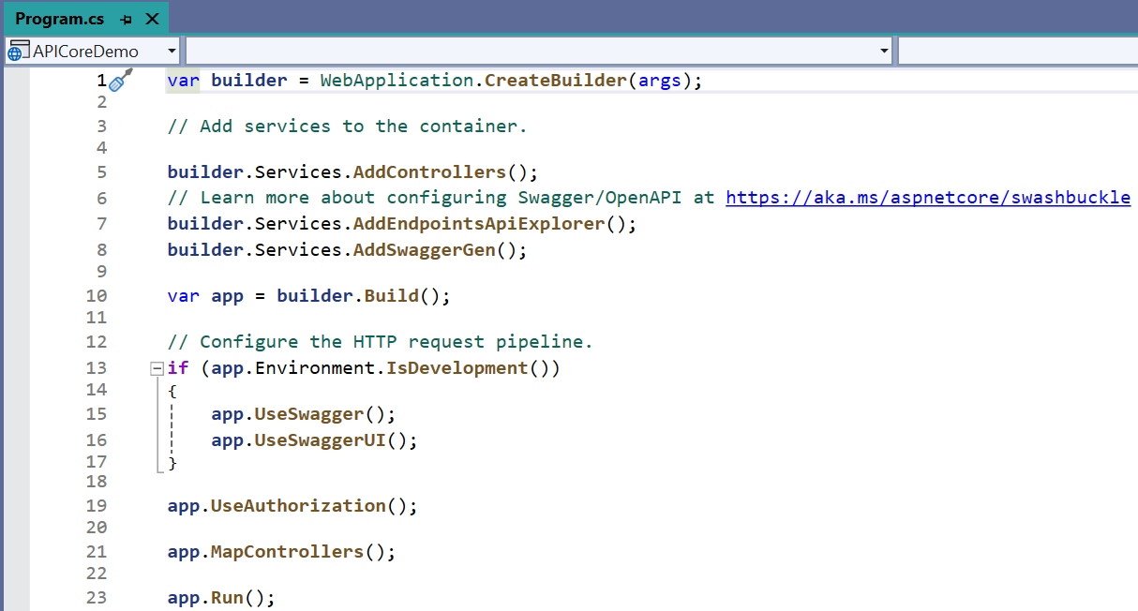
Middleware in ASP.NET Core Cont.. (In MVC Project)

Slide 83
Run, Use, Next, and Map Methods in Middleware
In order to work with ASP.NET Core Middleware Components, we need to learn about few methods are as follows:
Run() Method:
The Run() Extension Method is used to complete the Middleware Execution.
i.e. app.Run();
Use() Method:
The Use() Extension Method is used to insert a new Middleware component to the Request Processing Pipeline.
i.e. app.UseSwagger(); | app.UseSwaggerUI(); | app.UseAuthorization(); etc.
Next() Method:
The Next() Extension Method is used to call the next middleware component in the request processing pipeline.
Map() Method:
The Map() Extension Method is used to map the Middleware to a specific URL.
i.e. app.MapControllers();

Slide 84
Summary

Slide 85
Summary: Introduction & Architecture
Overview
ASP.NET Core is a cross-platform, high-performance framework for building modern web applications.
Built on .NET Core and supports MVC architecture.
Key Features
Cross-platform, Dependency Injection, Middleware-based pipeline, Razor Pages, Tag Helpers, Built-in DI.
Advantages
Fast performance, modular, testable, cloud-ready, unified development model for Web APIs and UIs.
Architecture Pattern
MVC (Model-View-Controller):
Model: Business/data logic.
View: UI rendering.
Controller: Handles requests & controls flow.

Slide 86
Summary: Project Structure & Core Concepts
Project Layout
MVC: Controllers/ – Request handlers, Models/ – Data structures & logic, Views/ – Razor pages (.cshtml)
wwwroot/ – Static files (CSS, JS), Program.cs – Configuration & Middleware registration
ASP.NET Core Life Cycle
Request enters via Kestrel
Middleware pipeline processes it
Routing maps it to controller/action
Controller handles logic
View renders UI Response returned to client
Request-Response Pipeline
Built using middleware.
Each middleware can handle or forward the request.
Common: Static Files, Routing, Authentication, Custom Middleware.
Middleware
Software units for handling HTTP requests. Added in Program.cs using app.UseXyz().

Slide 87
Summary: MVC Components
Models
Represent application data and business rules.
Often use Entity Framework for data access.
Views
Razor syntax with .cshtml files.
Combines HTML + C# to render UI.
Action Methods
Defined inside controllers. Handles HTTP verbs: GET, POST, etc.
Return View(), Redirect(), Json(), etc.
Layouts
Common template for views (like _Layout.cshtml).
Contains shared UI (e.g., header, footer, nav).
Partial Views
Reusable parts of the UI.
Rendered inside views using @Html.Partial() or @await Html.PartialAsync().

Slide 88
Summary: MVC View Data Management & Razor Engine
ViewBag, ViewData, TempData
ViewBag: Dynamic, short-lived; for passing data from controller to view.
ViewData: Dictionary-based; similar to ViewBag but less flexible.
TempData: Stores data temporarily for the next request only.
Introduction to Razor View
Razor is a view engine used to render dynamic content in C# web apps.
Uses .cshtml files with HTML + C# syntax.
Advantages of Razor View
Clean, readable syntax.
Supports IntelliSense.
Fast and secure rendering.
Razor Syntax
Inline C#: @{ var x = 10; }
Output: @Model.Name
Control structures: @if, @foreach, etc.

Slide 89
Web Programming using .NET
#2305CS311
Prof. Madhuresh R Fichadiya
Computer Science & Engineering Department
madhuresh.fichadiya@darshan.ac.in
8866961282

